Slide 1
Adam Astor
Image Classification for Clothing Articles

Slide 2
Adam Astor
Image Classification for Clothing Articles
Can a deep learning model accurately classify articles of clothing it has never seen before?
Predicting real estate prices in California

Slide 3
Adam Astor
Image Classification for Clothing Articles
Clothing is a necessity that people around the world wear every day.
Clothing makes a statement about who you are and gives a sense of identity.
Is there a way to predict what type of clothing is being shown without human eyes looking at it?
Predicting real estate prices in California

Slide 4
Adam Astor
Image Classification for Clothing Articles
Data Analyzed
70,000 articles of clothing properties observed in study.
Data refers to 10 different categories of clothing.
Raw data available here
Predicting real estate prices in California

Slide 5

Adam Astor
Image Classification for Clothing Articles
Data Cleaning
Data has been cleaned and labeled ahead of time for ease of use.
Most of the focus is on model building and evaluating.
Predicting real estate prices in California
Predicting real estate prices in California

Slide 6
Adam Astor
Image Classification for Clothing Articles
Label | Description
0 | T-shirt/top
1 | Trouser
2 | Pullover
3 | Dress
4 | Coat
5 | Sandal
6 | Shirt
7 | Sneaker
8 | Bag
9 | Ankle boot
Exploratory Data Analysis
Ten classes of image data in the dataset
7,000 images per category
Split into 60,000 training images and 10,000 test images
Predicting real estate prices in California

Slide 7
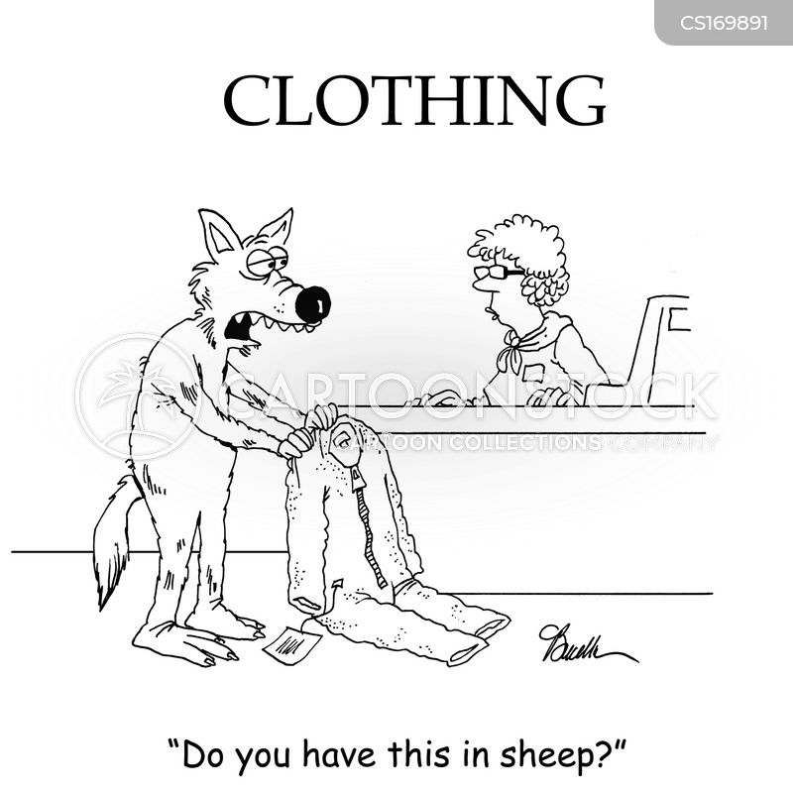
Adam Astor
Image Classification for Clothing Articles

Slide 8
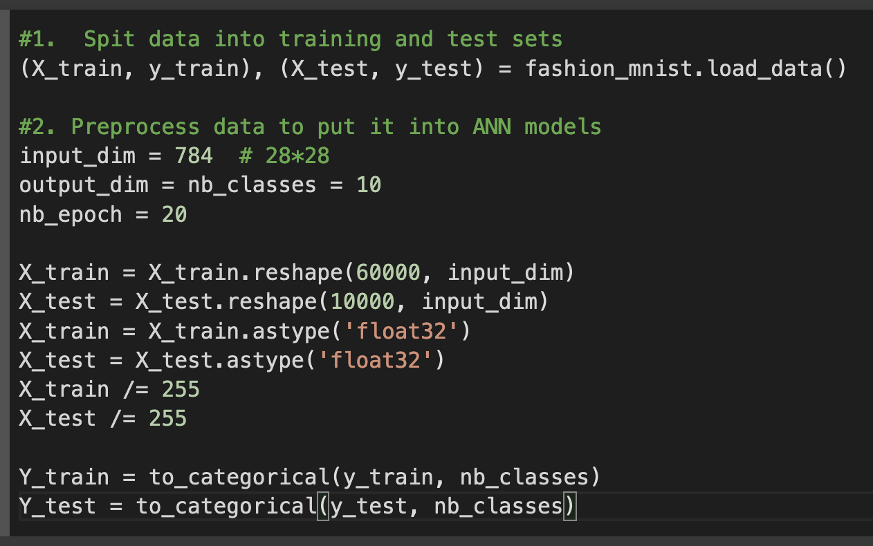
Adam Astor
Image Classification for Clothing Articles
Deep Learning Modeling
First, I split the data into training and test sets, then preprocessed the data by transforming it into a single dimension matrix and one-hot encode the labels (Y_train, Y_test).

Slide 9
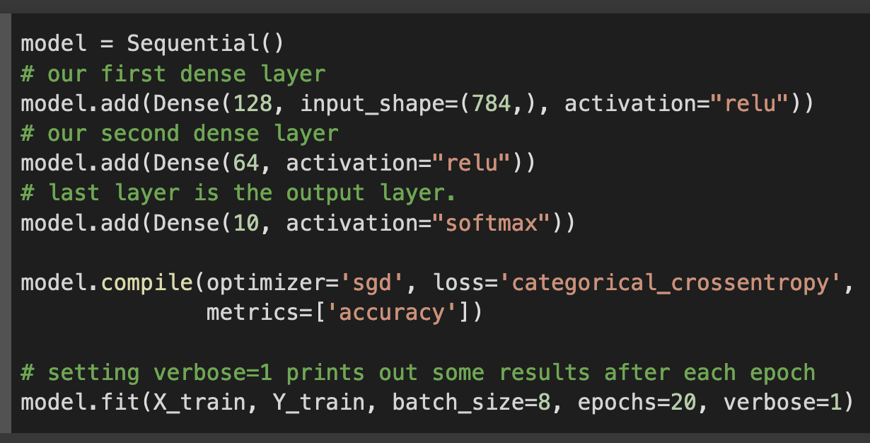
Adam Astor
Image Classification for Clothing Articles
Deep Learning Modeling
Next, I build an initial Sequential model with three layers, ReLu activation function, 123, 64 and 10 neurons with an SGD optimizer and categorical crossentropy loss function.

Slide 10
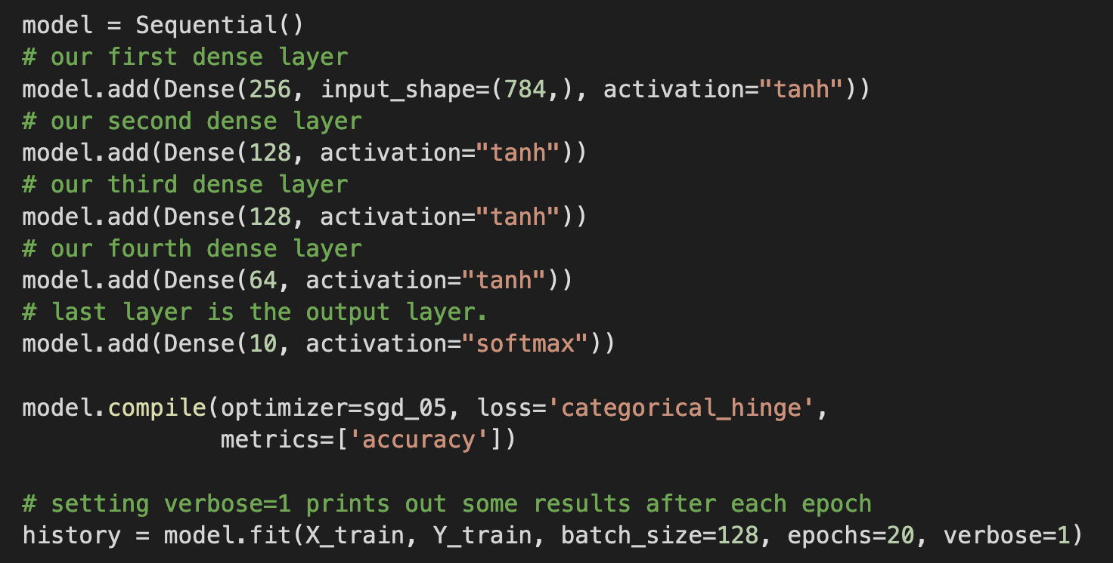
Adam Astor
Image Classification for Clothing Articles
Deep Learning Modeling
Through 30 iterations of tuning hyperparameters I concluded that the model shown is the best model based on a balance of accuracy and run time.

Slide 11
Adam Astor
Adam Astor
Image Classification for Clothing Articles
Deep Learning Modeling Hyperparameters
5-layer model with 256, 128, 128, 64, and 10 Neurons
All 5 layers are Dense layers
Hyperbolic tangent activation function
SGD Optimizer with learning rate of 0.5
Categorical Hinge loss function
128 batch size, 20 epochs
Predicting real estate prices in California

Slide 12
Adam Astor
Image Classification for Clothing Articles
Deep Learning Model Evaluation
K folds cross validation with ten folds
Accuracy (ratio of the number of correctly classified cases to the total of cases under evaluation): 86.14%
Weakest at predicting class 6 (shirt), strongest at predicting class 1 (trouser)

Slide 13
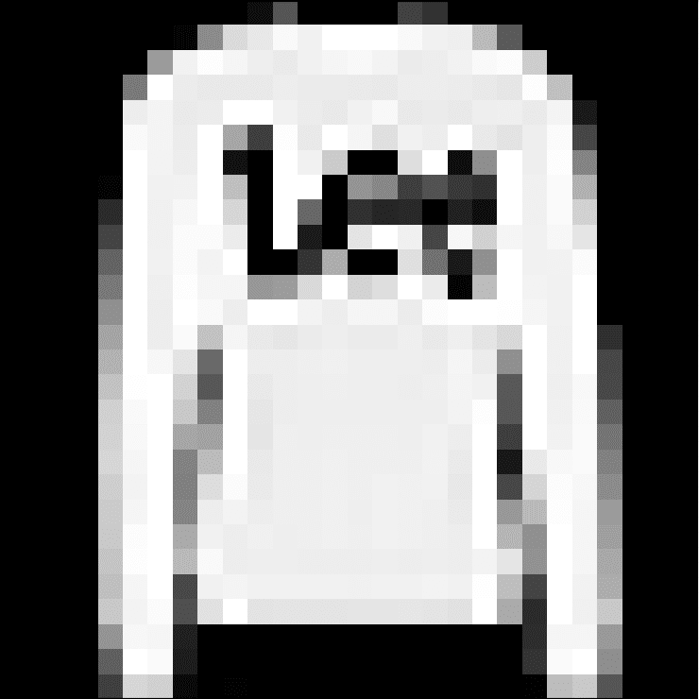
Adam Astor
Image Classification for Clothing Articles
Prediction
To test the model, we had it predict which class this image of a pullover belonged to. It accurately classified the image as class 2 (Pullover).

Slide 14
Adam Astor
Adam Astor
Image Classification for Clothing Articles
Conclusion
We can conclude that we have made a robust image classification model that can accurately identify images of clothing articles.
Predicting real estate prices in California

Slide 15
Adam Astor
Adam Astor
Image Classification for Clothing Articles
Recommendations
To implement this model in a business use-case to begin reaping the benefits of image classification.
Predicting real estate prices in California

Slide 16
Adam Astor
Adam Astor
Image Classification for Clothing Articles
Whats Next?
To continue expanding on my work, I would continue to test the model on more types of images. I would take more color images and transform them so the model can work with them. I would also test different types of models other than Sequential to compare what model works best.
Predicting real estate prices in California

Slide 17
Questions?

Slide 18
Thank You

